Slide 1
Can we predict the next “Top Hit” according to Spotify?
By Tana Larson, Jennifer Powell, & Daniel Torres

Slide 2

Orginally…
What age group listens to rap?
Do people listen to any specific genre in the winter?
Who are a specific artist’s top demographic?
However...
Do certain factors make a song a top hit?
Are songs trending in any direction with energy or tempo?
What are certain artists’ top hits?

Slide 3
Three Factors
Danceability
Danceability describes how suitable a track is for dancing based on tempo, beat strength, and overall regularity.
Energy
Energy is a measure from 0.0 to 1.0 that represents a perceptual measure of internsity and activity. For example, death metal has a high energy.
Tempo
The overall tempo of a track is in BPM (beats per minute). Overall it is the speed or pace of the song.

Slide 4
Data Exploration Process
Spotify’s data was already cleaned up
Pulled the data from a site that directly used Spotify’s API
Surprising how much Spotify’s AI are able to analyze a song

Slide 5


Difficulties that arose
Can only see stuff about these artist and song not about who is listening to it.
Privacy protection.
Demographic limitation
Pulling LOTS of data at once about many songs.

Slide 6
What did we figure out?
We found out that yes there are trends in what directions tempo, danceability, and energy are going.
But no, you can’t really predict a song’s ability
to be a top hit based on these factors.

Slide 7
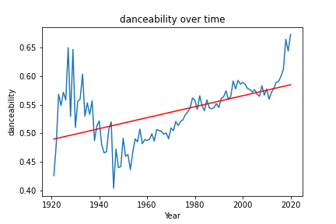
1.Danceability
How is danceability trending over the years?
If further explored…
What is Spotify’s main demographic? Are younger or older generations feeding this data?

Slide 8
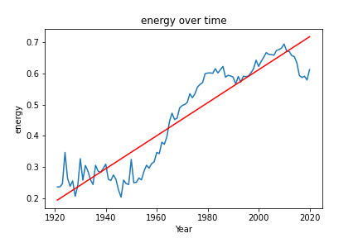
2.Energy
How is energy trending over the years?
If further explored…
What caused these dips? How do historical events have an impact on these trends?

Slide 9
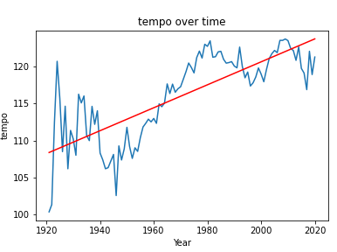
3.Tempo
How is tempo trending over the years?
If further explored…
Can we predict the future of these factors or are they just random?

Slide 10
Do the “Top Hits” have a certain energy, danceability, or tempo?

Slide 11
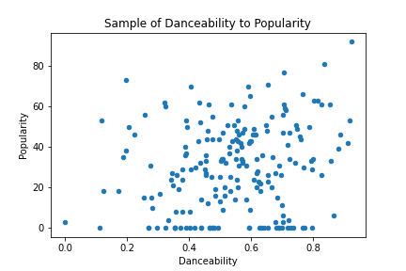
1.Danceability
It is concluded that…
Danceability is essentially random.

Slide 12
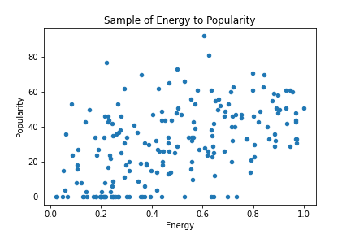
2. Energy
How is energy trending over the years?
It is concluded that…
Energy is even more spread out.

Slide 13
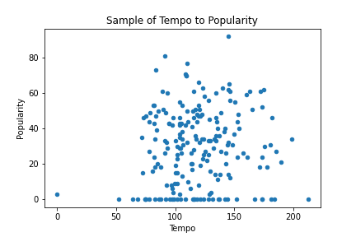
3. Tempo
How is energy trending over the years?
Genre vs BPM
Hip-Hop: 60-100
House: 115-130
Dubstep: 135-145

Slide 14
What we concluded
You can’t base a song’s ability to be a top hit by these three factors
Danceability, tempo, and energy are all rising with time
Spotify has major limitations when it comes to their privacy policy

Slide 15
Thank you!
Any questions?

